Slide 1

Final Year Project Presentation on Eco-Fertilization
Presented by :
Gaurav Sharma (1AT18CS128)
Ishita Katiyar (1AT18CS044)
Arpit Chakraborty (1AT18CS020)
Sumukha Hegde (1AT18CS129)
Under the Guidance
Dr. Manash Sarkar
Associate Professor

Slide 2
Content
Abstract
Introduction/Motivation
Literature Review
Objectives
State-of-Art
Methodology
Implementation Model
Data Preparation
Data Description
Implementation Algorithm
Results
Future Scope
Conclusion
References

Slide 3
Abstract
Fertilizer use is typically under the limited control of farmers. For the farmers to achieve higher yields and reduce fertilizer loss, competent guidance is required for the best use of these fertilizers. Additionally, there is a connection between rainfall volume and nutrient loss for various fertilizer applications after each rainfall event. Rainfall that is moderate and falls at the right moment can help nutrients penetrate the soil's rooting zone and dissolve dry fertilizer. However, too much rain can increase the possibility of runoff and the pace at which nutrients like nitrogen (N) which is quintessential, phosphorus (P), and potassium (K) which are crucial, manganese (Mn), and boron (B) that are present in the soil. This research presents nutrient recommendations using an updated iteration of the random forest algorithm which is based on time-series data to forecast the required quantity of nutrients for various crops by examining rainfall patterns and crop fertility. The method suggested in this study, comes in handy for improving soil fertility by providing nutrients recommendations for optimum conditions for crop growth and reducing leaching and runoff potential.

Slide 4
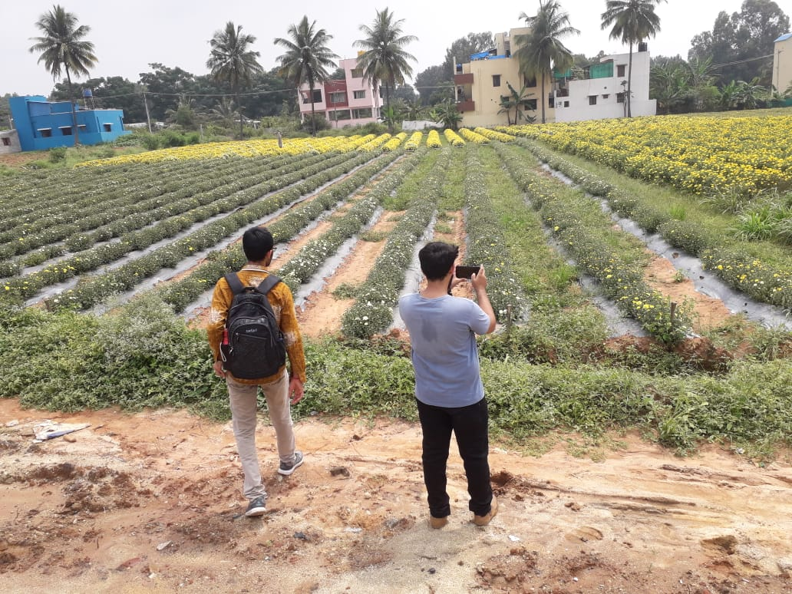
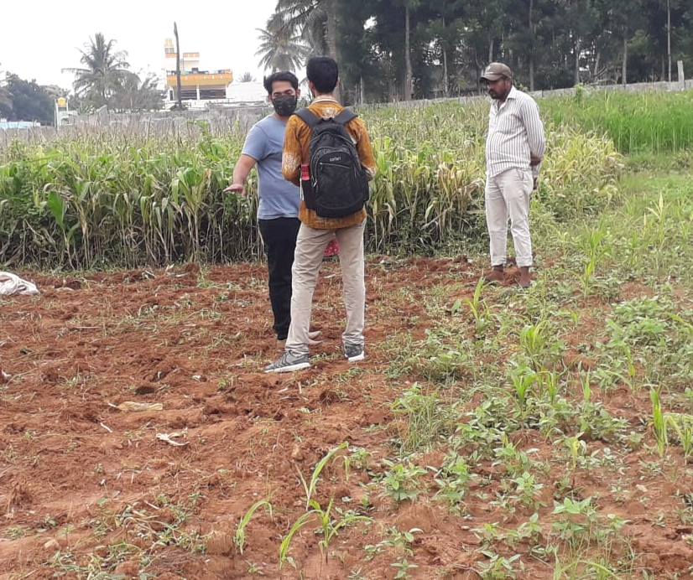
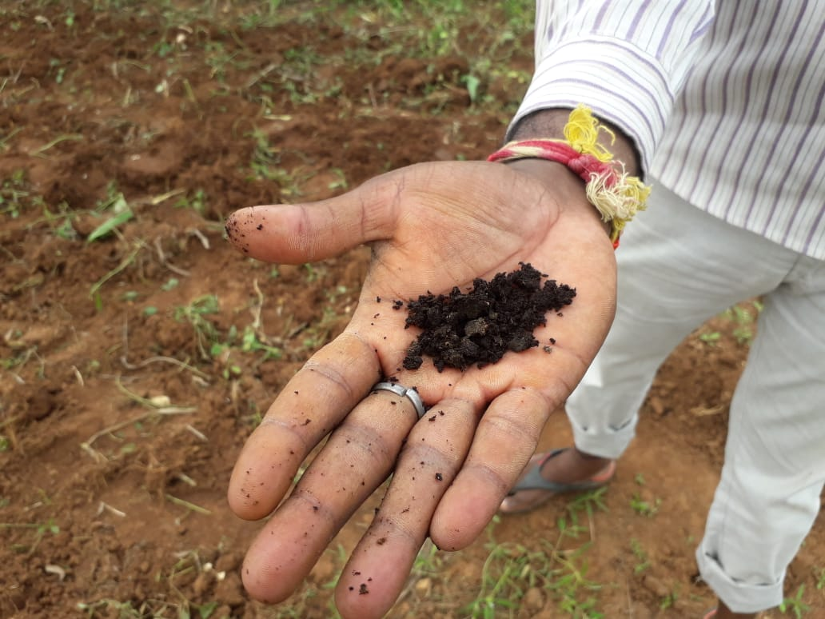

Introduction / Motivation
1
Unbalanced progress in rural and urban areas.
2
Analysis of farmers' problems at the ground level.
3
The problem statements are analyzed and determined based on what is in our study area.

Slide 5
Literature Review
Ref No. | Year | Title | Author’s Name | Journal | Description
1. | 2018 | Prediction of Crop Fertilizer Consumption | Krutika Hampannavar, Vijay Bhajantri Shashikumar G. Totad | IEEE, DOI:10.1109/ICCUBEA.2018.8697827 | Prediction of fertilizer consumption can prevent the toxicity and deficiency in plants to certain extent and this can help farmers to get proper yield without much wastage.
2. | 2018 | Fuzzy decision support system for improving the crop productivity and efficient use of fertilizers | G. Prabakaran,D. Vaithiyanathan, Madhavi Ganesan | Computers and Electronics in Agriculture ,ISSN : 0168-1699 (Elsevier) | This paper explores the process of using fuzzy logic systems to reduce fertilizer consumption and improve crop productivity.
3. | 2018 | Data Mining Techniques for Crop Yield Prediction | Shital Bhojani Nirav Bhatt | Computers and Electronics in Agriculture, ISSN: 0168-1699 (Elsevier) | It's a difﬁcult task to predict crop yield due to stochastic rain fall pattern and also variation in temperature. So we can apply different data mining techniques for crop yield predication and can produce an efﬁcient algorithm for crop classiﬁcation for better.

Slide 6
Literature Review
Ref No. | Year | Title | Author’s Name | Journal | Description
4. | 2019 | Estimation of NPK requirements for rice production in diverse Chinese environments under optimal fertilization rates | Yulong Yin, Hao Ying Huifang Zheng ,Qingsong Zhang ,Yanfang Xue, Zhenling Cui | Agricultural and Forest Meteorology, ISSN : 0168-1923 (Elsevier) | Objectives of this study were to evaluate the relationship between nutrient requirements and climates or soil chemical properties.
5. | 2020 | Rainfall intensification increases nitrate leaching from tilled but not no-till cropping systems in the U.S. Midwest | Laura J.T. Hess Eve-Lyn S. Hinckley G. Philip Robertson Pamela A. Matson | Agriculture, Ecosystems & Environment, ISSN : 0167-8809 (Elsevier) | Rainfall intensification may exacerbate leaching losses of reactive N from cropping systems, and that no-till management may buffer against these losses.
6. | 2020 | Crop Yield Prediction Based on Indian Agriculture using Machine Learning | Potnuru Sai Nishant Pinapa Sai Venkat Bollu Lakshmi Avinash B. Jabber | 2020 International Conference for Emerging Technology (INCET) | This paper predicts the yield of almost all kinds of crops in India. This script makes novel by usage of simple parameters like state, district, season, area and the user can predict the yield of the crop in which year he or she wants to.

Slide 7
Literature Review
Ref No. | Year | Title | Author’s Name | Journal | Description
7. | 2020 | Cropping systems in agriculture and their impact on soil health | TonyYang, Kadambot H.M. Siddique, Kui Liu | Global Ecology and Conservation, ISSN: 2351-9894 (Elsevier) | Significant achievements, including refine content of soil health and the development of new evaluation standards for ‘soil health and quality’.
8. | 2020 | Would fertilization history render the soil microbial communities and their activities more resistant to rainfall fluctuations? | János Kátai Ágnes Oláh Zsuposné Magdolna Tállai Tarek Alshaal | Ecotoxicology and Environmental Safety, ISSN: 0147-6513 (Elsevier) | This paper aims to study the intrinsic changes in the composition of soil populations and their functions due to the interaction between long-term fertilization and rainfall fluctuations, seeing whether fertilization history would render the soil microbial communities and their activities more resistant to water stress or not.
9. | 2021 | A nutrient recommendation system for soil fertilization based on Evolutionary Computation. | Usman Ahmed Jerry Chun-Wei Lin Gautam Srivastava Youcef Djenouri | Computers and Electronics in Agriculture, ISSN: 0168-1699 (Elsevier)) | This paper develops a model that enables efficient exploration of correct usage of nutrients (such as N, P and K) for developing a knowledge-based system for the ICT (Information and Communication Technology) environment.

Slide 8
Literature Review
Ref No. | Year | Title | Author’s Name | Journal | Description
10. | 2021 | Controlled traffic farming effects on productivity of grain sorghum, rainfall and fertiliser nitrogen use efficiency | A.Hussein Diogenes L. Antille Shreevatsa Kodur GuangnanChen Jeff N.Tullberg | Journal of Agriculture and Food Research | Enhanced efficiency fertilizers cannot compensate for other stresses caused by compaction.
11. | 2021 | Optimized fertilizer recommendation method for nitrate residue control in a wheat–maize double cropping system in dryland farming | Zujiao Shi, Donghua Liu, Miao Liu, Muhammad Bilal Hafeez, Pengfei Wen, Xiaoli Wang, Rui Wang, Xudong Zhang, Jun Li | Field Crops Research ISSN: 0378-4290 (Elsevier) | To optimize the fertilizer recommendation method and reduce nitrate residue levels, this paper establishes the relationships between crop yield, nitrogen requirement, and nitrate residue level under combined N and P fertilizer application.
12. | 2021 | Analysis of agricultural crop yield prediction using statistical techniques of machine learning | Janmejay Pant, R.P. Pant, Manoj Kumar Singh, Devesh Pratap Singh, Himanshu Pant | Materials Today: Proceedings, ISSN: 2214-7853 (Elsevier) | This paper suggests the use of Machine Learning techniques to create a trained model for detecting patterns in data, which we then used to predict crop yields. The application of machine learning to the prediction of four of India's most cultivated yields is considered in this study. Maize, potatoes, rice (paddy), and wheat are among these crops.

Slide 9
Literature Review
Ref No. | Year | Title | Author’s Name | Journal | Description
13. | 2021 | Prediction of the production of crops with respect to rainfall. | Benny Antony | Environmental Research, ISSN: 0013-9351 (Elsevier) | This paper predicts the production of crops as a function of rainfall. This is implemented by generating a rough overview of how the production is based on rainfall and how much can a specific crop production for the amount of rainfall it receives. The proposed method of evaluation is better than other existing methods of evaluation as it evaluates all the regression techniques.
14. | 2021 | Factors affecting agriculture and estimation of crop yield using supervised learning algorithms | Akash Manish Lad, K. Mani Bharathi, B. Akash Saravanan, R. Karthik | Materials Today: Proceedings, ISSN: 2214-7853 (Elsevier) | Comprehensive method developed to estimate crop sustainability using supervised algorithms that increase crop yields, reduce manual labor, time spent on various agricultural activities and plant recommendations based on certain soil parameters.
15. | 2021 | Precision agriculture using IoT data analytics and machine learning | Raves Akhtar, Shabbir Ahmad Sofi | Journal of King Saud University - Computer and Information Sciences,ISSN: 1319-1578(Elsevier) | This paper proposes an apple disease prediction model in apple orchards in Kashmir Valley using data analysis and machine learning in an IoT system. The paper discusses the challenges faced when integrating these technologies into traditional agricultural approaches.

Slide 10
Literature Review
Ref No. | Year | Title | Author’s Name | Journal | Description
16. | 2021 | Farmers' risk preference and fertilizer use | Fang-binQIAOJi-kunHUANG | Journal of Integrative Agriculture | This study examines the role of farmers' risk attitudes toward fertilizer use in cotton production.
17. | 2022 | Untangling the effect of soil quality on rice productivity under a 16-years long-term fertilizer experiment using conditional random forest | Saheed Garnaik, Prasanna Kumar Samant, Mitali Mandal, Tushar Ranjan Mohanty, Sanat Kumar Dwibedi, Ranjan Kumar Patra, Kiran Kumar Mohapatra, R.H. Wanjari, Debadatta Sethi, Dipaka Ranjan Sena, Tek Bahadur Sapkota, Jagmohan Nayak, Sridhar Patra, Chiter Mal Parihar, Hari Sankar Nayak. | Computers and Electronics in Agriculture, ISSN: 0168-1699(Elsevier) | The study demonstrated how interpretable machine learning techniques can be used in long-term fertilizer experiments to produce the most meaningful information, and that these techniques can be used in other similar long-term experiments.
18. | 2022 | Agricultural decision system based on advanced machine learning models for yield prediction: Case of East African countries | Rubby Aworka, Lontsi Saadio Cedric, Wilfried Yves Hamilton Adoni, Jérémie Thouakesseh Zoueu, Franck Kalala Mutombo, Charles Lebon Mberi Kimpolo, Tarik Nahhal, Moez Krichen | Smart Agricultural Technology, ISSN: 2772-3755 (Elsevier) | Crop Random Forest, Crop Gradient Boosting Machine, and Crop Support Vector Machine are three crop prediction models proposed in this paper. The paper makes use of advanced machine learning models to develop a decision system based on climate data, crop production data, and pesticide data.

Slide 11
Literature Review
Ref No. | Year | Title | Author’s Name | Journal | Description
19. | 2022 | Smart farming using Machine Learning and Deep Learning techniques | Senthil Kumar Swami Durai, Mary Divya Shamili | Decision Analytics Journal, ISSN: 2772-6622(Elsevier) | The purpose of this paper is to help an individual farm be efficient and thus achieve high yield at a low cost. It also helps to predict the total costs required for growth. It will help one to plan ahead Pre-cultivation activities lead to an integrated solution in agriculture.
20. | 2022 | Improving the prediction accuracy of soil nutrient classification by optimizing extreme learning machine parameters | M.S. Suchithra, Maya L. Pai | Information Processing in Agriculture, ISSN: 2214-3173 (Elsevier) | This paper suggests solutions to the classification problems of soil nutrient which are solved using the fast learning classification technique known as Extreme Learning Machine (ELM) with different activation functions.

Slide 12

Objectives
1
To provide useful information for fertilizer use in terms of nutrients (NPK) by considering weather forecasts.
2
To reduce water pollution by slowing down the process of leaching.
Source : Google [21]

Slide 13
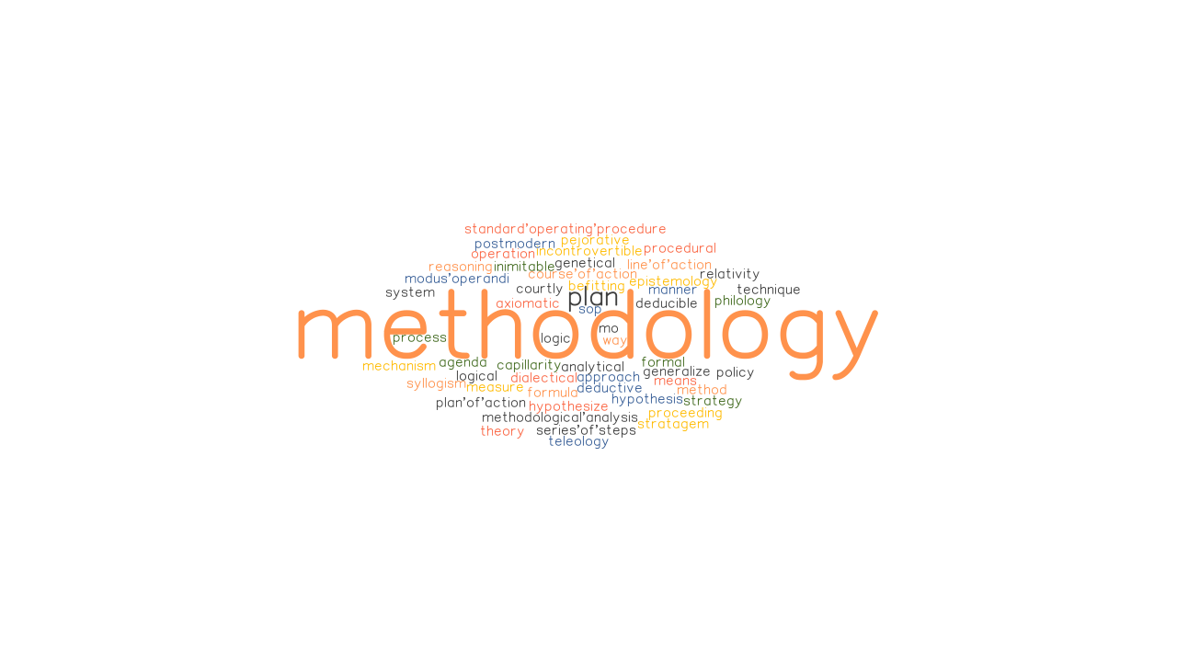
State-of-Art
Tools & Technologies :
Jupyter Notebook
Python
Matplotlib
HTML / CSS
Flask
VS Code
Image Source : Google [22]

Slide 14
Methodology
In this study, a predictive model for the nutrients required for crops was obtained using random forest. Random Forest Regression represents the model with K-Fold Cross Validation technique and the model with acceptable accuracy for the prediction is then obtained. A total of 7 features have been used to evaluate the algorithm.
The algorithm requires input from the user (such as location and cropping). The location is fed to the Weather API which will return certain characteristics (e.g. temperature, humidity, rainfall) and if there is a possibility of heavy rainfall, a precautionary message is displayed to the user, otherwise the proposed algorithm is followed.

Slide 15
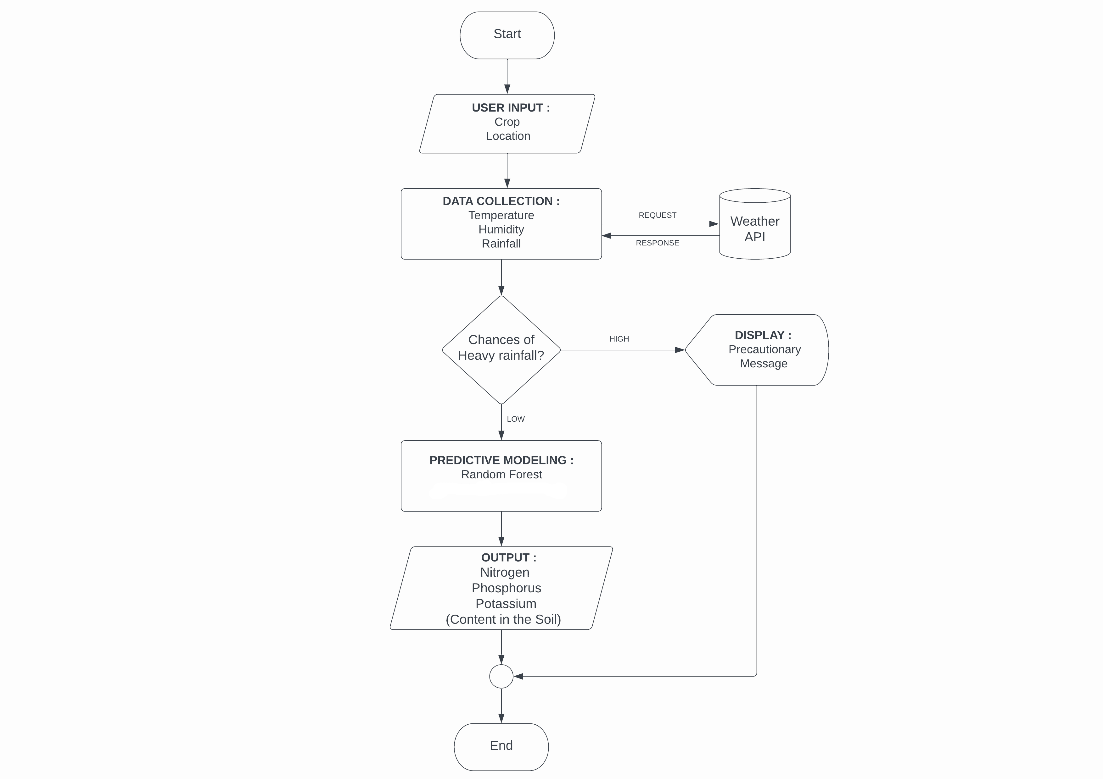
Implementation Model
Flowchart :

Slide 16
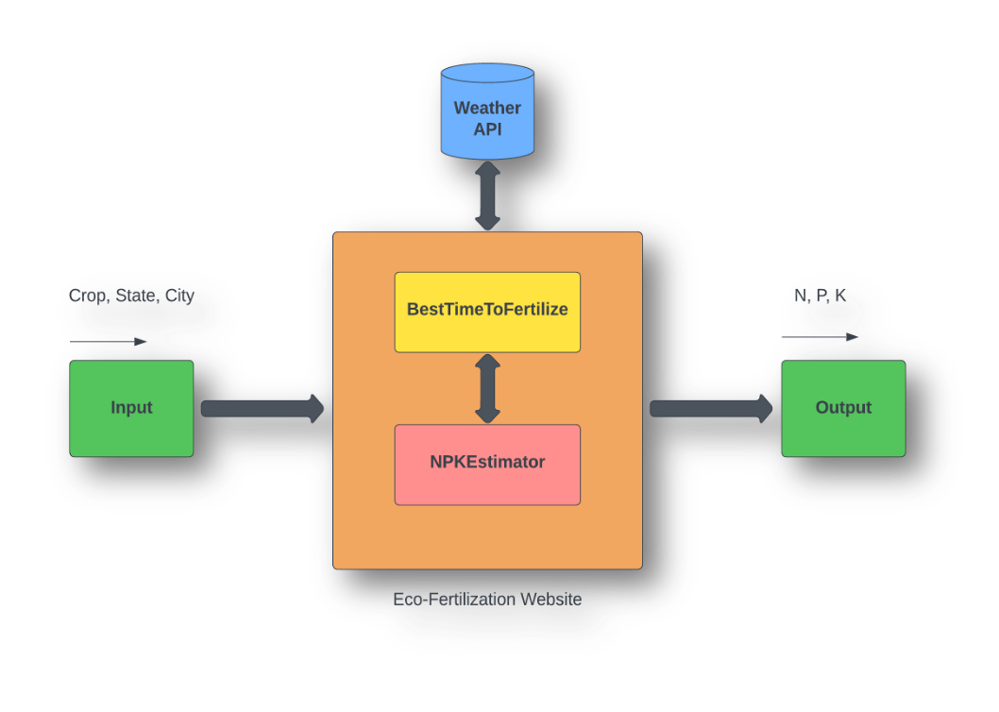
Implementation Model
Block Diagram :
System architecture is a conceptual model that defines the structure and behavior of the system. It comprises of the system components and the relationships describing how they work together to implement the overall system. The Figure shows the system’s architecture and the various components added to them.
The description of each component from the block diagram and their major functionalities with respect to the Eco-Fertilization as a complete unit is described in the table below.
S. no. | Block Name | Functions
1 | Input | User provides data such as crop , state and city using drop down menu
2 | Weather API | Weather details like temperature, rainfall etc is fetched from the weather API
3 | BestTimeToFertilize | This module provides the functionality to determine the best time to fertilize using fetched weather data and provides warming for heavy rain.
4 | NPKEstimator | This module estimates the required ratio of NPK contents in the soil.
5 | Output | Nitrogen, Phosphorus and Potassium content displayed on the website

Slide 17
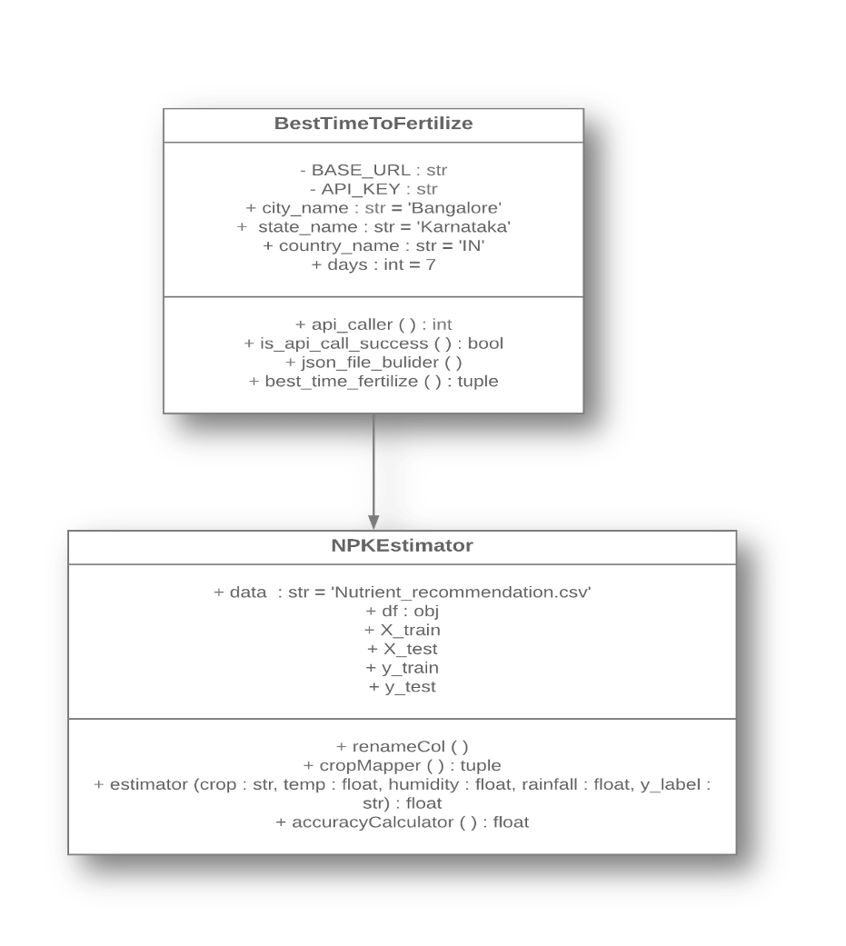
Implementation Model
Class Diagram :
Class diagram is a static diagram. It represents the static view of an application.
Class diagram is not only used for visualizing, describing, and documenting different aspects of a system but also for constructing executable code of the software application.
Class diagram shows a collection of classes, interfaces, associations, collaborations, and constraints.
It is also known as a structural diagram.

Slide 18
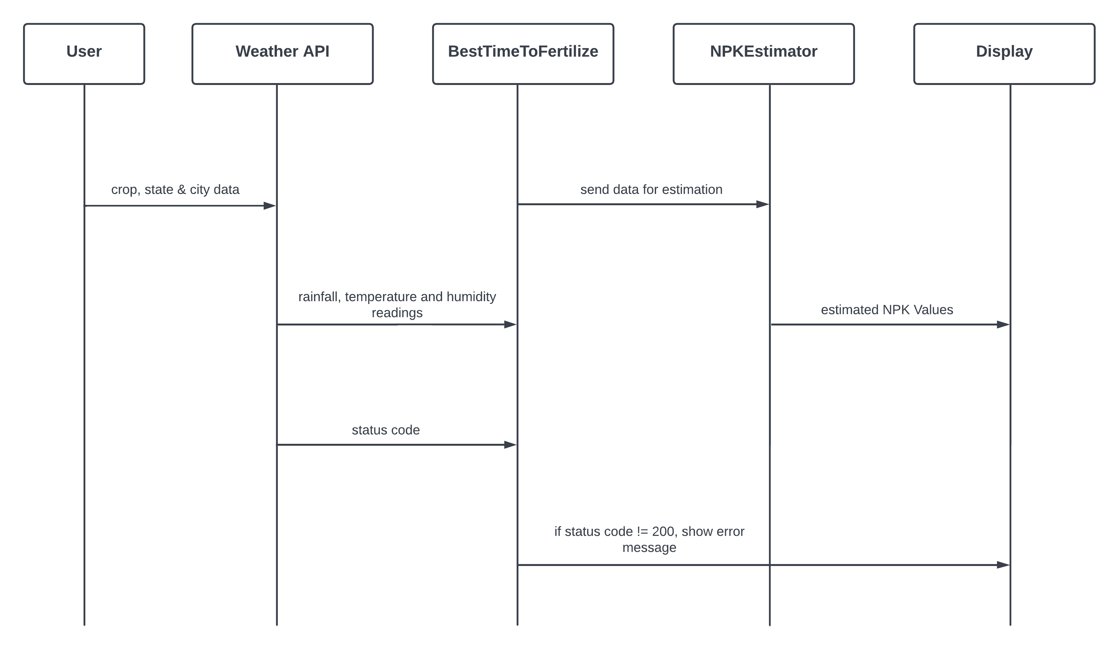
Implementation Model
Sequence Diagram :
A sequence diagram shows object interactions arranged in time sequence.
It depicts the objects and classes involved in the scenario and the sequence of messages exchanged between the objects needed to carry out the functionality of the scenario.
Sequence diagrams are typically associated with use case realizations in the Logical View of the system under development.
Sequence diagrams are sometimes called event diagrams or event scenarios.
A sequence diagram consists of parallel vertical lines (lifelines) which shows different processes or objects that live simultaneously, and horizontal arrows that depicts the messages exchanged between them, in the order in which they occur.
This allows the specification of simple runtime scenarios in a graphical manner.

Slide 19
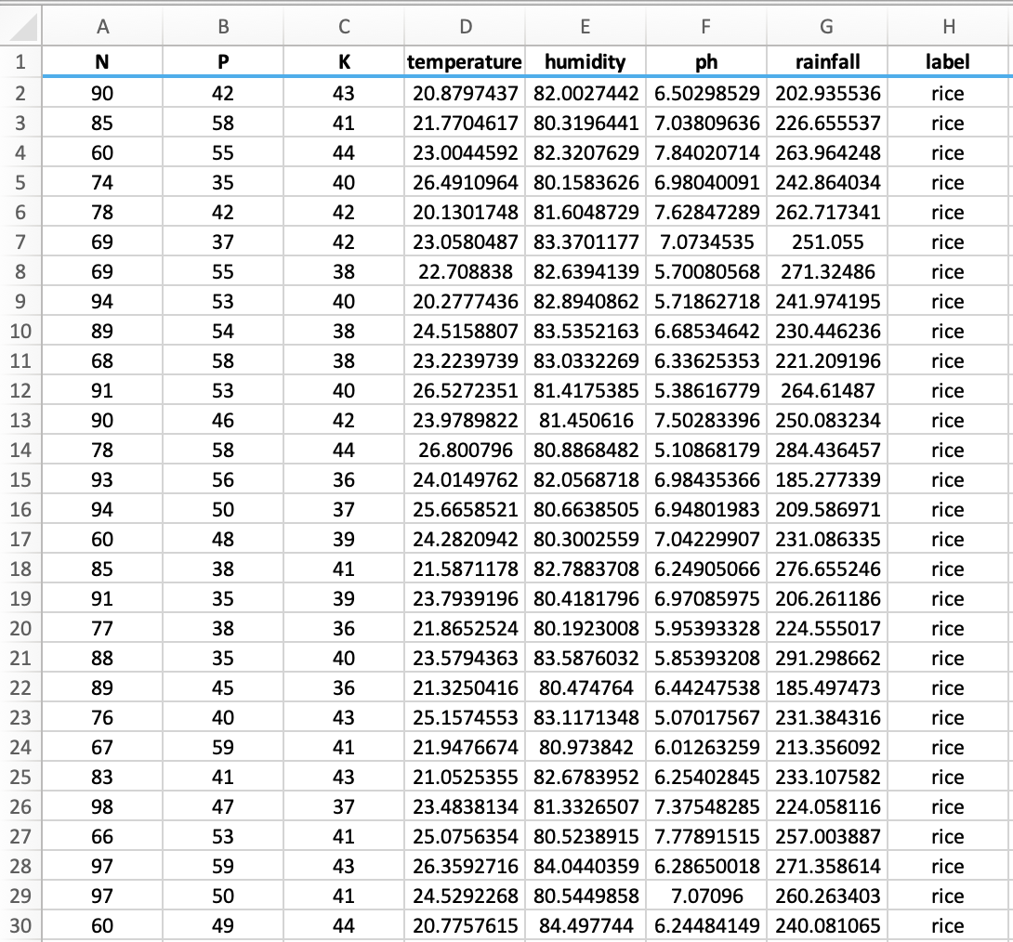
Data Preparation
Actual Dataset :
Crop Recommendation Dataset [23]
Last access date : 16.11.2021

Slide 20
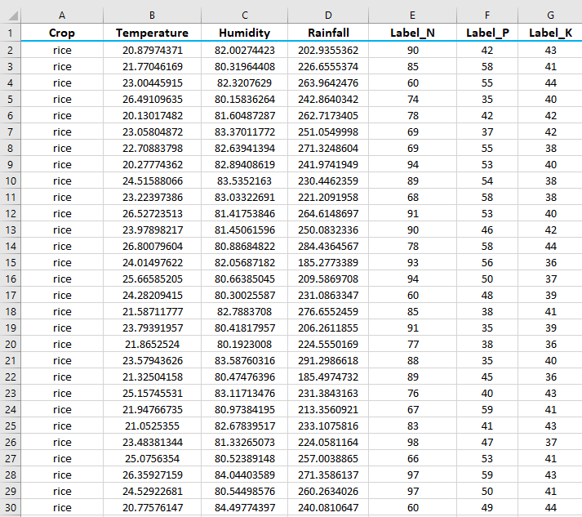
Data Preparation
Actual Dataset contains 8 features. All of the features are not useful for proposed model. Therefore, a dimension reduction technique called feature selection is applied and seven features, then selected for evaluation
Customized Dataset

Slide 21
Data Description
Input Features :
Crop : rice, cotton, etc.
Temperature : temperature in degree Celsius
Humidity : relative humidity in percentage
Rainfall : rainfall in mm
Output Features :
Label_N : ratio of Nitrogen content in soil
Label_P : ratio of Phosphorous content in soil
Label_K : ratio of Potassium content in soil

Slide 22
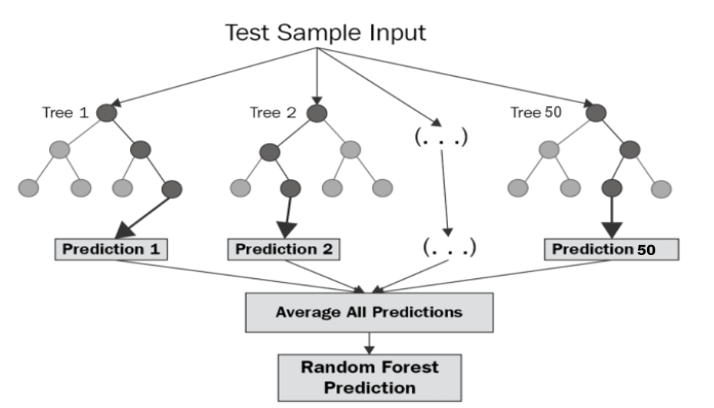
Implementation Algorithm
Random Forest Regression :
Random forest (RF) is a collection of multiple decision trees that have variable hyper-parameters and are trained using varying subsets of data.
In our project,we are going to take crop and location as input, and based on it, we will predict the value of N, P, and K.
First, we will divide our dataset into training and test datasets, where the training dataset is 80% of the original data and the rest 20% is test data.
Then we will create three different random forests of size 50 (decision tree) for each N, P, and K and outputs the mean of the classes as the prediction of all the trees, shown in Table

Slide 23
Implementation Algorithm
Algorithm : Random Forest Regression
BEGIN :
Step 1 : Split the dataset n=2200 into training and test dataset (Where training set is 80% and test set is 20% that is training set=1,760 and test set=240).
Step 2 : Apply random forest regression to each N, P and K (Nitrogen, Phosphorus & Potassium) value with n_estimators=50 (n_estimators is the number of decision tree).
Step 3 : Train N_label, P_Label and K_Label with the training dataset and dependent variable (Where dependent variable is N for N_Label, P for P_Label and K for K_Label).
Step 4 : Each N_Label, P_Label and K_Label generates a 50 decision tree as an output based on training dataset.
END

Slide 24
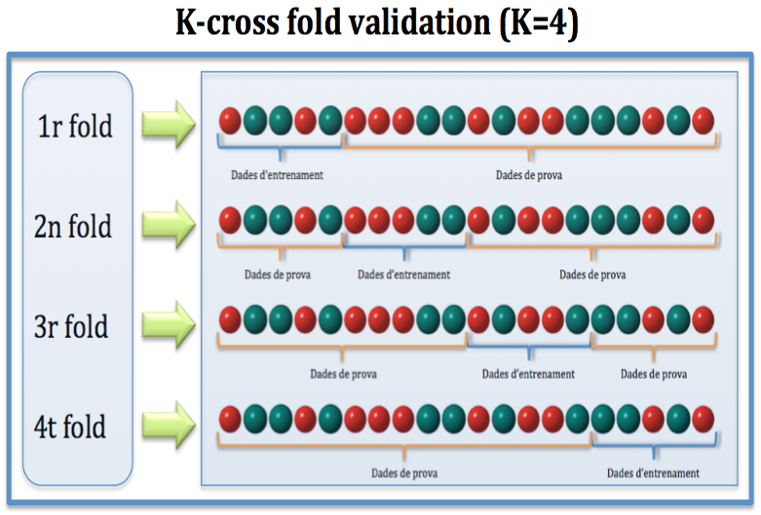
Implementation Algorithm
Cross Validation :
Cross-validation is a resampling technique for testing machine learning models on a small set of data.
The algorithm has only one parameter, k, which determines how many groups a given data sample should be divided into. As a result, k-fold cross-validation is a common name for the procedure.
When a specific number for k is supplied, it can be used in place of k in the model's reference, such as k=4 for 4-fold cross-validation.

Slide 25
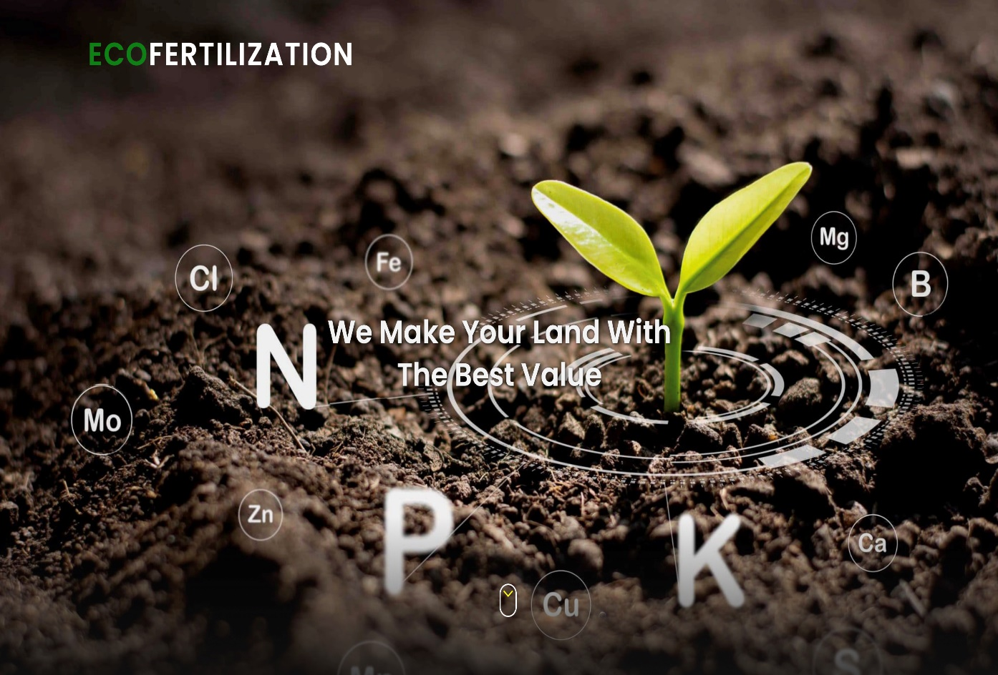
Results
Eco-Fertilization, a user-friendly system, has been implemented in the form of a website to provide cross-platform functionality and suggest appropriate timings and amount of nutrients required for an inputted crop with a heavy rainfall alert system (as shown in figures).
Homepage of Eco-Fertilization

Slide 26


Results
Input Form
Details filled using the drop-down menu

Slide 27

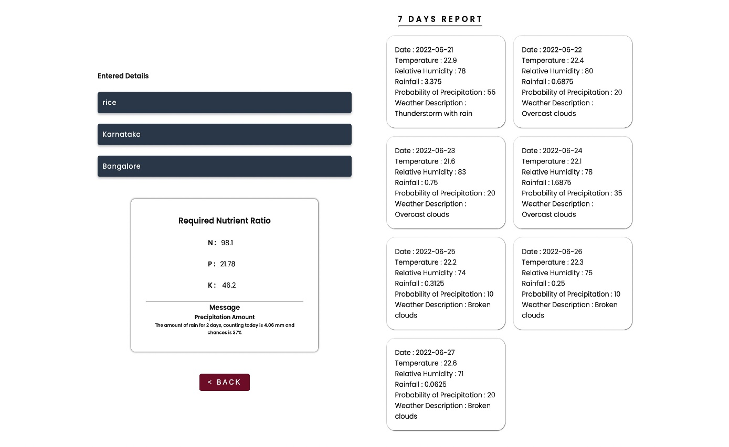
Results
Applying Algorithm to inputted details
Output with seven days of weather forecasts & alerts/messages

Slide 28

Future Scope
The proposed system provides a helping hand to our farmers. It gives information about the use and quantity of nutrients required by the crops. There is scope for improvement in the system by providing user interface in the native language, so that the user can operate the system easily if he or she is unfamiliar with the English language. In addition, speech recognition systems can be added to handle illiterate users.
Source : futurescope.io [24]

Slide 29

Conclusion
The proposed system is able to achieve 92% of accuracy, which is quite good for any predictive model. It provides information about the use and the amount of nutrients required by the crops for satisfactory crop growth and production with respect to weather conditions. It provides weather alerts and messages. Alerts are displayed in the output of this application in case of bad weather conditions. The accuracy can be improved further with development in technologies
Source :dreamstime[25]

Slide 30
References
[1] Krutika Hampannavar,Vijay Bhajantri,Shashikumar G. Totad , “Prediction of Crop Fertilizer Consumption,” Fourth International Conference on Computing Communication Control and Automation (ICCUBEA), 2018, PP. 1-5
[2] G. Prabakaran,D. Vaithiyanathan, Madhavi Ganesan , “Fuzzy decision support system for improving the crop productivity and efficient use of fertilizers ,” Computers and Electronics in Agriculture, vol-150, 2018, PP. 88-97
[3] Shital Bhojani,Nirav Bhatt, “Data Mining Techniques for Crop Yield Prediction,” Computers and Electronics in Agriculture, vol-6, 2018, PP. 357-358
[4] Yulong Yin, Hao Ying,Huifang Zheng ,Qingsong Zhang ,Yanfang Xue,Zhenling Cui , “Estimation of NPK requirements for rice production in diverse Chinese environments under optimal fertilization rates ,” Agricultural and Forest Meteorology, vol-279, 2019, PP. 1-6
[5] Laura J.T. Hess,Eve-Lyn S. Hinckley,G. Philip Robertson,Pamela A. Matson , “Rainfall intensification increases nitrate leaching from tilled but not no-till cropping systems in the U.S. Midwest ,” Agriculture, Ecosystems & Environment, vol-290, 2020, PP. 1-10
[6] Potnuru Sai Nishant,Pinapa Sai Venkat,Bollu Lakshmi Avinash,B. Jabber , “Crop Yield Prediction Based on Indian Agriculture using Machine Learning,” 2020 International Conference for Emerging Technology (INCET), 2020, PP. 1-4
[7] Tony Yang,Kadambot H.M. ,Siddique,Kui Liu , “Cropping systems in agriculture and their impact on soil health ,” Global Ecology and Conservation, vol-23, year, PP. 1-13
[8] János Kátai,Ágnes Oláh Zsuposné,Magdolna Tállai,Tarek Alshaal, “Would fertilization history render the soil microbial communities and their activities more resistant to rainfall fluctuations? ,” Ecotoxicology and Environmental Safety, vol-201, 2020, PP. 1-11
[9] Usman Ahmed,Jerry Chun-Wei Lin, Gautam Srivastava,Youcef Djenouri , “A nutrient recommendation system for soil fertilization based on Evolutionary Computation,” Computers and Electronics in Agriculture, vol-189, 2021, PP. 1-7
[10] A.Hussein , Diogenes L. Antille , Shreevatsa Kodur , GuangnanChen,Jeff N.Tullberg , “Controlled traffic farming effects on productivity of grain sorghum, rainfall and fertiliser nitrogen use efficiency,” Journal of Agriculture and Food Research, vol-3, 2021, PP. 1-17
[11] Zujiao Shi, Donghua Liu, Miao Liu, Muhammad Bilal Hafeez, Pengfei Wen, Xiaoli Wang, Rui Wang, Xudong Zhang, Jun Li , “Optimized fertilizer recommendation method for nitrate residue control in a wheat–maize double cropping system in dryland farming ,” Field Crops Research , vol-271, 2021, PP. 1-10

Slide 31
References
[12] Janmejay Pant, R.P. Pant, Manoj Kumar Singh, Devesh Pratap Singh, Himanshu Pant , “Analysis of agricultural crop yield prediction using statistical techniques of machine learning ,” Materials Today: Proceedings, vol-46, 2021, PP. 1-10
[13] Benny Antony , “Prediction of the production of crops with respect to rainfall.,” Environmental Research, vol-202, 2021, PP. 1-5
[14] Akash Manish Lad, K. Mani Bharathi, B. Akash Saravanan, R. Karthik, “Factors affecting agriculture and estimation of crop yield using supervised learning algorithms ,” Materials Today: Proceedings,, 2022, PP. 1-10
[15] Raves Akhtar, Shabbir Ahmad Sofi, “Precision agriculture using IoT data analytics and machine learning,” Journal of King Saud University - Computer and Information Sciences, 2021, PP. 1-17
[16] Fang-binQIAOJi-kunHUANG, “Farmers' risk preference and fertilizer use,” Journal of Integrative Agriculture,vol-20, PP. 1987-1995
[17] Saheed Garnaik, Prasanna Kumar Samant, Mitali Mandal, Tushar Ranjan Mohanty, Sanat Kumar Dwibedi, Ranjan Kumar Patra, Kiran Kumar Mohapatra, R.H. Wanjari, Debadatta Sethi, Dipaka Ranjan Sena, Tek Bahadur Sapkota, Jagmohan Nayak, Sridhar Patra, Chiter Mal Parihar, Hari Sankar Nayak, “Untangling the effect of soil quality on rice productivity under a 16-years long-term fertilizer experiment using conditional random forest,” Computers and Electronics in Agriculture, vol-197,2022, PP. 1-10
[18] Rubby Aworka, Lontsi Saadio Cedric, Wilfried Yves Hamilton Adoni, Jérémie Thouakesseh Zoueu, Franck Kalala Mutombo, Charles Lebon Mberi Kimpolo, Tarik Nahhal, Moez Krichen, “Agricultural decision system based on advanced machine learning models for yield prediction: Case of East African countries,” Smart Agricultural Technology, vol-3, 2022, PP. 1-9
[19] Senthil Kumar Swami Durai, Mary Divya Shamili, “Smart farming using Machine Learning and Deep Learning techniques,” Decision Analytics Journal, vol-2, 2022, PP. 1-30
[20] M.S. Suchithra, Maya L. Pai, “Improving the prediction accuracy of soil nutrient classification by optimizing extreme learning machine parameters,” Information Processing in Agriculture, vol-7, 2022, PP. 1-11

Slide 32
References
[21] mtdtraining , “ https://www.mtdtraining.com/wp-content/uploads/2017/11/objective-setting.jpg ” (accessed on 6th April 2022)
[22] Grammartop, “ https://grammartop.com/wp-content/uploads/2020/11/methodology-488f1a23453770c85d6bba8200517e430312982e.png ” (accessed on 6th April 2022)
[23] Kaggle, “ https://www.kaggle.com/datasets/atharvaingle/crop-recommendation-dataset ” (accessed on 16th November 2021)
[24] futurescope , “ https://www.futurescope.ie/wp-content/uploads/2020/12/Logo.png” (accessed on 22nd June 2022)
[25] Dreamstime , “ https://thumbs.dreamstime.com/b/conclusion-conclusion-sign-conclusion-paper-origami-speech-bubble-conclusion-tag-conclusion-banner-124314194.jpg” (accessed on 21st June 2022)

Slide 33
THANK YOU

